Slide 1
Ratio
A ribbon is cut into 3 pieces, A, B, C, in the ratio of
1: 2 : 4. If C is longer than B by 16 cm, find the length of the ribbon?

Slide 2
Ratio
A ribbon is cut into 3 pieces, A, B, C, in the ratio of
1 : 2 : 4. If C is longer than B by 16 cm, find the length of the ribbon?
A : B : C = 1 : 2 : 4
If C – B = 2, then total length = 7
If C – B = 4, then total length = 14
If C – B = 16, then total length = 56

Slide 3
Ratio
If the ratio of the sides of 2 squares is 2 : 3, find the ratio of their areas.

Slide 4
Ratio
If the ratio of the sides of 2 squares is 2 : 3, find the ratio of their areas.
Areas = 2x2 : 3x3 = 4 : 9

Slide 5
Ratio
If the ratio of the sides of 2 cubes is 1 : 3, what is the ratio of their volumes?

Slide 6
Ratio
If the ratio of the sides of 2 cubes is 1 : 3, what is the ratio of their volumes?
Volume ratio = 1 : 27

Slide 7
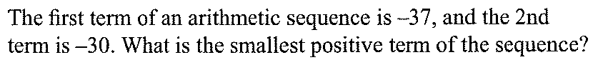
Arithmetic Sequence

Slide 8
Arithmetic Sequence
There is a difference of 7 between the terms
-37, -30, -23, -9, -2, 5

Slide 9
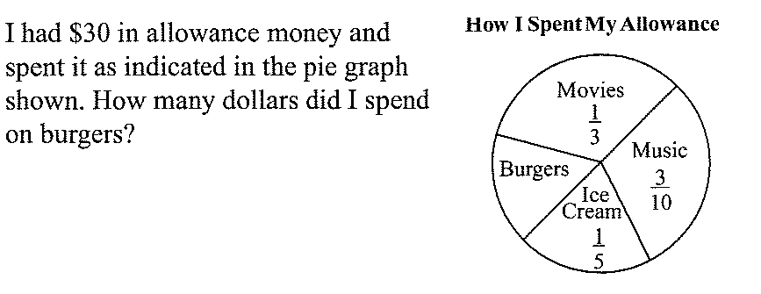
Fractions

Slide 10
Fractions
1/3 + 3/10 + 1/5 = 10/30 + 9/30 + 6/30 = 25/30 = 5/6
1- 5/6 = 1/6 (on burgers)
30(1/6) = 5

Slide 11
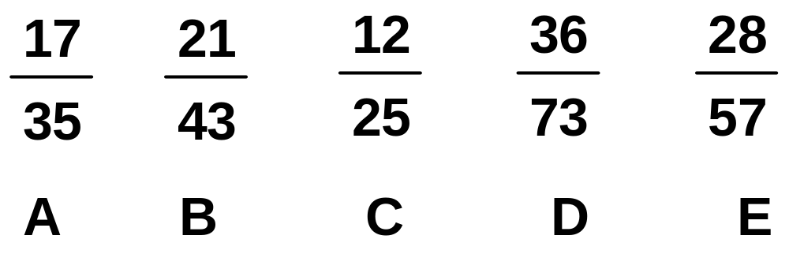
Fractions
Which of the fractions below is the largest and smallest? (no calculator allowed)

Slide 12
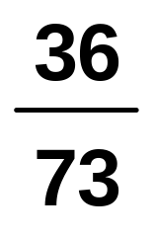
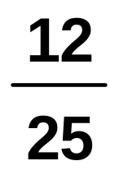
Fractions
Which of the fractions below is the largest and smallest? (no calculator allowed)
is the largest (D)
is smallest (C)

Slide 13
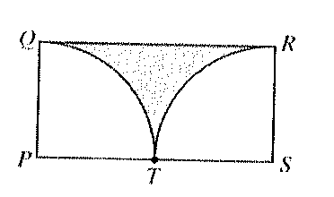
Area
In rectangle PQRS, arcs QT and RT are quarter circles
with centers P and S, respectively. If the radius of
each quarter is 1, what is the area of the shaded area?
1 – π/4
2 – π/2
2 – π/4
π/4
2/3

Slide 14
Area
In rectangle PQRS, arcs QT and RT are quarter circles
with centers P and S, respectively. If the radius of
each quarter is 1, what is the area of the shaded area?
1 – π/4
2 – π/2
2 – π/4
π/4
2/3

Slide 15
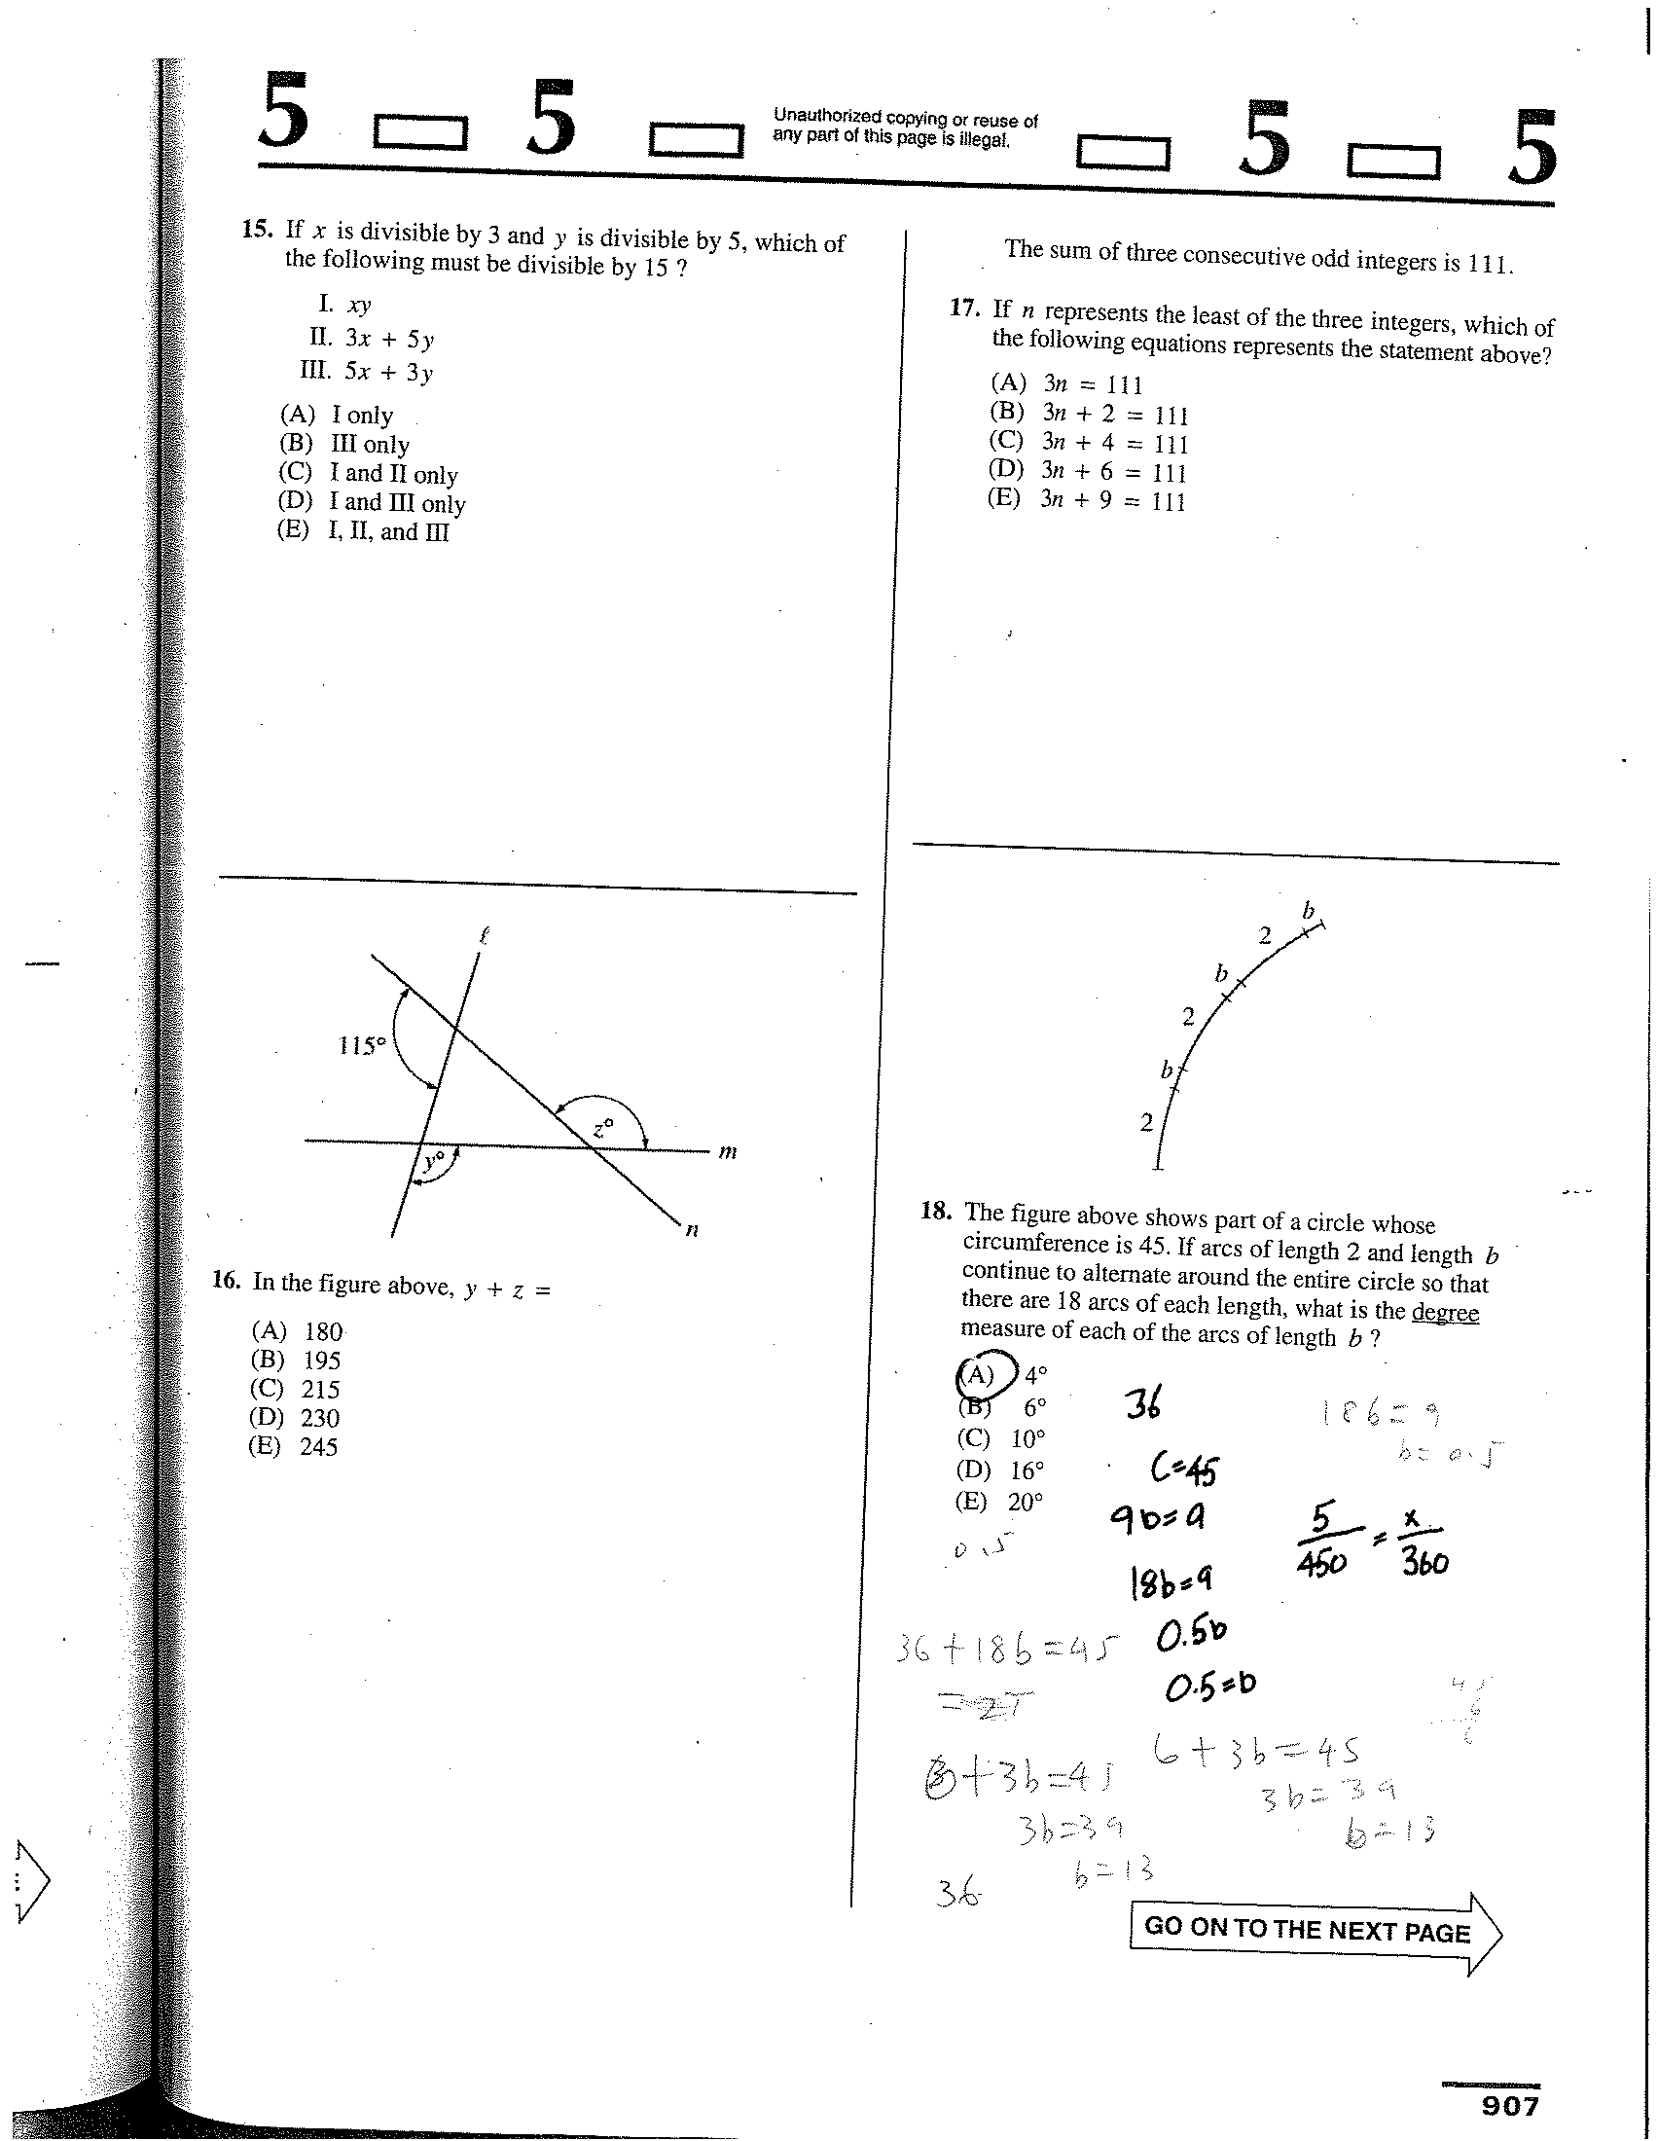
Circle

Slide 16
Circle
18(b+2) = 45
18b + 36 = 45
b = 0.5
360 x (0.5/45)
= 360/90
= 4
4º

Slide 17
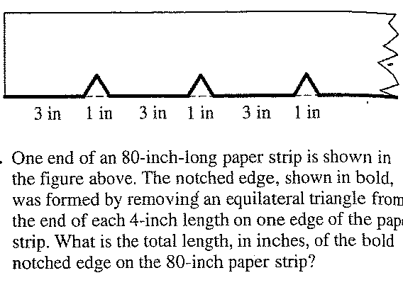
Triangle

Slide 18
Triangle
120 x (5/4) = 100 in

Slide 19
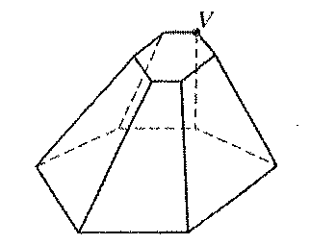
Questions of the Week (7th)
The three dimensional figure has two parallel bases
and 18 edges. Line segments are to be drawn
connecting vertex V with each of the other 11 vertices
in the figure. How many of these segments will not lie
on an edge of the figure?

Slide 20
Questions of the Week (7th)
The three dimensional figure has two parallel bases
and 18 edges. Line segments are to be drawn
connecting vertex V with each of the other 11 vertices
in the figure. How many of these segments will not lie
on an edge of the figure? 8 (11 – 3)

Slide 21
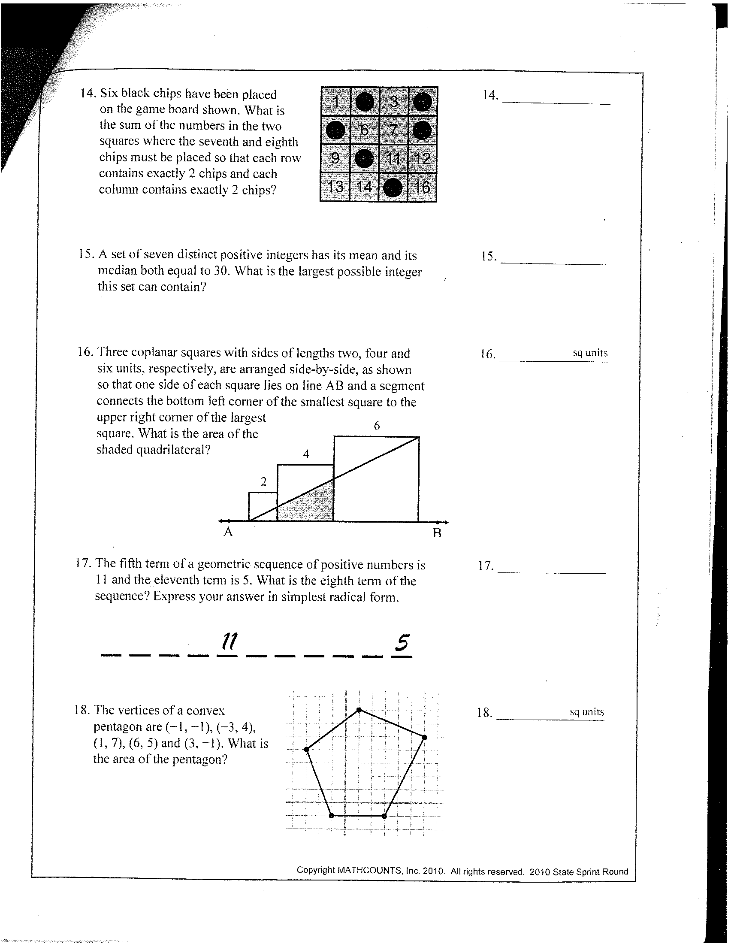
Area

Slide 22
Area
8 sq units

Slide 23
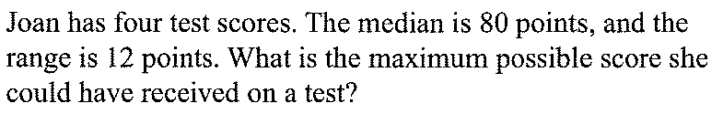
Median

Slide 24
Median
80, 80, 80, 92

